Slide 1
MAHARISHI INTERNATIONAL UNIVERSITY
1971-1995
MAHARISHI UNIVERSITY
of
MANAGEMENT
Engaging the Managing
Intelligence of Nature

Slide 2
Lab 5:
State Pattern

Slide 3
State : Example without state pattern
public class Person {
private String state;
public void setState(String st){
state=st;
}
public void talk(){
if (state.equals("hungry"))
System.out.println("I want food");
else
if (state.equals("sleepy"))
System.out.println("I want to sleep");
else
if (state.equals("dirty"))
System.out.println("I need a bath");
else
if (state.equals("happy"))
System.out.println("I feel good");
}
}
public class Application {
static public void main(String args[]) {
Person p=new Person();
p.setState("hungry");
p.talk();
p.setState("happy");
p.talk();
p.setState("sleepy");
p.talk();
p.setState("dirty");
p.talk();
}
}

Slide 4
State : Example with state pattern
public class DirtyPerson implements Person{
public void talk(){
System.out.println("I need a bath");
}
}
public class SleepyPerson implements Person{
public void talk(){
System.out.println("I want to sleep");
}
}
public class HappyPerson implements Person{
public void talk(){
System.out.println("I feel good");
}
}
public class HungryPerson implements Person{
public void talk(){
System.out.println("I want food");
}
}
public class Application {
static public void main(String args[]) {
Person p=new HungryPerson();
p.talk();
p=new HappyPerson();
p.talk();
p=new SleepyPerson();
p.talk();
p=new DirtyPerson();
p.talk();
}
}
public interface Person {
public void talk();
}

Slide 5
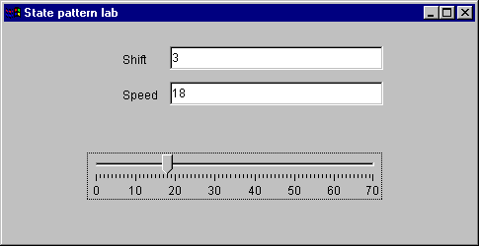
State : Lab
Shift car simulation
speed shift
x=0 park
0<x<5 1
5<x<10 2
10<x<30 3
30<x<55 4
x>55 5

Slide 6
State : Lab without pattern
public class Car{
public int changeSpeed(int speed){
if (speed == 0) {
return 0;
} else {
if (speed > 0 && speed < 5) {
return 1;
} else {
if (speed > 5 && speed < 10) {
return 2;
} else {
if (speed > 10 && speed < 30) {
return 3;
} else {
if (speed > 30 && speed < 55) {
return 4;
} else {
if (speed > 55 ) {
return 5;
}
}
}
}
}
}
return 0;
}
}

